Slide 1

Department of ICT
B.E Sem : IV ICT MU
Subject Name: Probability and Statistics Subject code : 01CT0401
Unit no. 1
Unit title: Introduction to Probability
Faculty Name:
Foram

Slide 2
Teaching Scheme & Exam Scheme

Slide 3
Course Content
Unit 1. Introduction to Probability
Classical and axiomatic definitions of probability, sample space, probability of an event, addition rule and conditional probability, multiplication rule, total probability, Bayes’ theorem and independence.
Unit 2. Random variable
Introduction to the concept, Discrete and continuous random variable: definitions and examples, Probability density function and cumulative distribution functions of continuous random variables, Probability mass function of discrete random variables, expected values and variance of discrete random variable.
Unit 4. Two – dimensional random variable
Joint distributions – Marginal and Conditional distributions, Covariance, regression, correlation, Independence of random variables.

Slide 4
1. Understand the needs of probability and distribution
2. Apply the mathematical treatment for random variable and joint probability distribution
3. Draw various graphs for the descriptive statistical analysis for the given data set and develop basic inference sense from it.
4. Apply appropriate probability distribution model, central limit for the given test cases.
5. Perform Test of Hypothesis as well as calculate confidence interval for a population parameter for single sample and two sample cases also Learn non-parametric test such as theChi-Square test for Independence as well as Goodness of Fit.
6. Perform Statistical analysis study like descriptive statistics, correlation and regression using professional software.
Course Outcome

Slide 5
References
Reference Books:
Introduction to Probability and Statistics for Engineers and Scientists, S. M. Ross, Academic Press, 2009.
Introductory Statistics by Neil Weiss ; tenth edition
Introduction to Probability and Statistics, J.S. Milton & J. C. Arnold, Cengage Learning, 2008
A First Course in Probability, S.M. Ross, Prentice Hall, 2001.

Slide 6
Introduction
Concept of probability Is originated from the game of chance like game of cards, tossing of coins or throwing a dice. So we need to understand the types of probability and operations related to it.

Slide 7
Random Experiment
A random experiment is any well-defined procedure that produces an observable outcome that could not be perfectly predicted in advance .
Throwing of an unbiased coin is a random experiment as out of two faces, any of the face i.e., head or tail may come up. Similarly throwing of an unbiased die is a random experiment as any of the six faces of the die may come up. In this experiment, there are six possibilities ( 1 or 2 or 3 or 4 or 5 or 6 ).

Slide 8
Random Experiment
More Examples :
Tossing a coin three times. Number of possible outcomes = 8. ...
Three coins are tossed simultaneously. ...
Rolling a pair of dice simultaneously. ...
Throwing a die two times. ...
Selecting a card from an urn containing 100 cards numbering from 1 to 100. ...
Choosing one of the factors of 180.

Slide 9
Sample Space
The set of all possible outcomes of a random experiment is called a sample space. It is generally denoted by S. The elements of a Sample space are called sample points.
For example, the sample space of a random experiment of tossing a coin is S = { H, T },
where H represents Head and T represents Tail.

Slide 10
Event
Events are the outcomes of an experiment. The probability of an event is the measure of the chance that the event will occur as a result of an experiment.
In other words, Any subset of a Sample Space is called an event.
For example, {H} is subset of S = {H,T}, therefore it is called event

Slide 11
Mutually Exclusive Events
In probability theory, two events are mutually exclusive or disjoint if they do not occur at the same time. If A and B are any events then , 𝐴⋂𝐵 = 𝜙; then A and B are mutually exclusive events.
Examples include: while tossing a coin we either get a head or tail but not both.
Right and left hand turns, even and odd numbers on a die, winning and losing a game, or running and walking.

Slide 12
Exhaustive Events
Let S be any sample space and A and B are two events of S such that 𝐴 ⋃ 𝐵 = S , then A and B are said to be exhaustive events.
In a throw of a coin, the possible outcomes are head and tail i.e., these are two exhaustive events (cases ). In the experiment of rolling a die, the outcomes 1,2,3,4,5,6 ( six cases ) are exhaustive.

Slide 13
Equally Likely Events
Events are said to be equally likely if there is no reason to expect any one in preference to any other. For example, in throw of a coin two cases i.e., head and tail are equally likely to come.

Slide 14
Independent Events
The events are said to be independent if the happening of one event does not depend upon the happening or non-happening of the other event. In the other case it is said to be dependent events.
Eg. In throwing two coins at a time, the outcome of one is independent of the second. But in case of a card is drawn from a pack of well shuffled cards and is not replaced, them, the second card is dependent on the first draw. The second draw is then a dependent event.

Slide 15
Favorable Events
The events which entail the required happening are said to be Favourable Events.
For example, in a throw of two dice, the number of cases favourable to getting a sum 7 is 6, (1,6);(6,1), (2,5);(5,2),(3,4); (4,3)

Slide 16
Complementary Events
If S is the sample space and event A ∈ 𝑆
𝑡ℎ𝑒𝑛 𝐴′ = S-A is said to be a complementary event.

Slide 17
Mathematical Definition of Probability:
Let an event A can happen in m ways and fail in n ways where all ways are being equally likely to occur, then the probability of the happening of event A is defined as,
P(A) =

Slide 18
While that of its failing is defined as P (not A )
Or
From above ,it may be noted that P(A)=p is such that .
is called the Complementary event. Also,

Slide 19
Notes
1) The Probability of happening an event A, while another event B has already happened is called the conditional probability of A such that B has already happened. It is usually denoted by P(A/B). This is the case when A and B are not independent events.
2) The Probability of happening an event A or event B is usually denoted by P(A)+P(B)
3) The Probability of happening of both events A and B is usually denoted by P(AB)

Slide 20
Theorems on Probability
Suppose there is an event A belonging to the sample space S. Then P(A) is probability of event A which satisfies the following theorems:
Non-Negativity : 0 ≤ 𝑃(𝐴) ≤ 1; ∀ 𝐴
Certainty : P(S) =1
Additivity : If A and B are two mutually exclusive events then occurring of A or B is given by
𝑃(𝐴 ∪ 𝐵) = 𝑃(𝐴) + 𝑃(𝐵)

Slide 21
Theorems on Probability
Note: If A and B are any two events in the sample space S then
𝐴 ⊂ 𝐵 𝑡ℎ𝑒𝑛 𝑃(𝐴) ≤ 𝑃(𝐵)
𝑃(𝐴 ∪ 𝐵) = 𝑃(𝐴) + 𝑃(𝐵) − 𝑃(𝐴⋂𝐵)
P(𝐴′ ∩ 𝐵′) = 1 − 𝑃(𝐴′ ∩ 𝐵′)′= 1-P(A∪ 𝐵)
P(𝐴′ ∪ 𝐵′) = 1 − 𝑃(𝐴′ ∪ 𝐵′)′= 1-P(A∩ 𝐵)
P(A∪ 𝐵 ∪ 𝐶) = 𝑃(𝐴) + 𝑃(𝐵) + 𝑃(𝐶) − 𝑃(𝐴 ∩ 𝐵) − 𝑃(𝐵 ∩ 𝐶) −𝑃(𝐴 ∩ 𝐶) + 𝑃(𝐴⋂𝐵 ∩ 𝐶)

Slide 22
Example 1
A fair dice is thrown then what is the probability of getting (i) at least 4 (ii) at most 5
Solution: S be the sample space.
Let A = The Event for getting at least 4
B = The Event for getting at most 5
S={ 1, 2, 3, 4, 5, 6 } , A= { 4, 5, 6} , B= { 1, 2, 3, 4, 5}
P(A) =1/6+1/6+1/6= 3/6= 1/2
and P(B)= 5/6

Slide 23
Example 2
An unbiased coin is tossed for three times. Find the probability of exactly two heads.
Solution: S= { HHH, HHT, HTH, THH, TTH, THT, HTT, TTT}
Let A be the event of getting exactly 2 heads. So, A= { HHT, HTH,THH}
P(A) = 3/8

Slide 24
Example 3
A bag contains 30 balls numbered 1 to 30. One ball is drawn at random find the probability that the number will be (i) multiple of 5 or 7 (ii) a multiple of 3 or 7
Solution: S= { 1,2,…..30}
A= Event of getting multiple of 5 = { 5, 10, 15, 20, 25 , 30} ∴ 𝑃(𝐴) = 6/30
B= Event of getting of multiple of 7 = { 7, 14, 21,28} ∴ 𝑃(𝐵)= 4/30
(i)Probability of multiple of 5 or 7 :
P(A∪ 𝐵) = 𝑃(𝐴) + 𝑃(𝐵)= 6/30+4/30= 1/3

Slide 25
(ii) Probability of multiple of 3 or 7:
A = multiple of 3 = { 3, 6, 9,12, 15, 18, 21, 24,27,30}
∴ 𝑃(𝐴) = 10/30
B= multiple of 7 = { 7, 14, 21,28}
∴ 𝑃(𝐵) = 4/30
Here 21 is the event which is occurring in both A and B so, 𝑃(𝐴 ∩ 𝐵)= 1/30
Probability of multiple of 3 or 7:
P(A∪ 𝐵) = 𝑃(𝐴) + 𝑃(𝐵) − 𝑃(𝐴 ∩ 𝐵)= ¹⁰ +
4 ₋ 1 ₌ 13
30 30 30 30

Slide 26


Example 4: A bag contains 8 white, 4 red balls, now 5 balls are drawn at random find the probability that 2 of them are white and 3 are red.
Solution : Total number of balls = 12
P(A) = probability of selecting 2 white balls: 𝑐⁸
P(B) = probability of selecting 3 red balls:

Slide 27
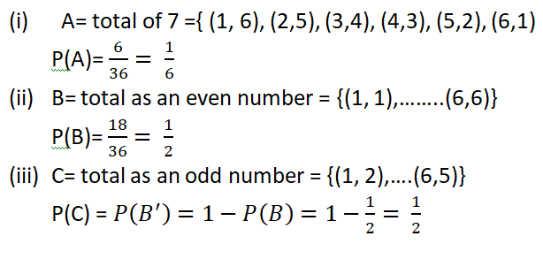
Example 5: Single throw of two dice find the probability of getting (i) Total of 7 (ii) Total of an even number (iii) Total of an odd number

Slide 28
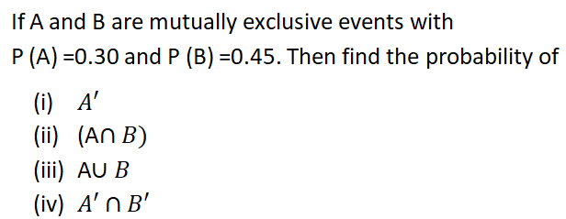
Example 6

Slide 29
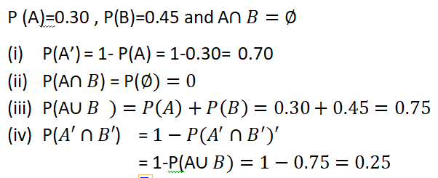
Solution

Slide 30
Example 7
What is the probability that if a card is drawn at random from an ordinary pack of cards, it is : (i) a black card (ii) a diamond (iii) one of the court card (face card)
(Note: 52 cards total ,26 black 26 red,4suits of 13 cards each i.e. spades hearts dimonds clubs)

Slide 31
Solution
Total no. of cases = 52
(1) There are 26 red cards and 26 black cards in a pack of cards
Favourable cases = 26 (number of black cards)
Probability of getting a black card =

Slide 32
(ii) No. of diamonds in a pack = 13
No. of favourable cases = 13
Probability of getting a diamond = 13/52
= ¼
= 0.25

Slide 33
(iii) There are 4 * 3 = 12 court cards in a pack of cards
So, no. of favourable cases = 12
no. of total cases = 52
so, the probability of getting a court card = 12/52 =3/13

Slide 34
Example 8
If 3 of 20 tyres in storage are defective and 4 of them are randomly chosen for inspection ( each tyre has the same chance of being selected), what is the probability that only one of the defective tyres will be included?

Slide 35
Solution
No of defective tyres = 3
No of non defective tyres = 17
Total no of exhaustive ways for getting 4 tyres from 20 tyres =
No of ways for selection of 1 defective tyre from 3 defective tyres and 3 non defective tyres from 17 non defecting tyres =

Slide 36
Required Probability

Slide 37
Example 9
Two dice are thrown together, find the probability that the sum is divisible by 2 or 3.

Slide 38
Solution
Let the event “the sum is divisible by 2” be denoted by A and the event “the sum is divisible by 3” be denoted by B.
Total no. of pairs = 6*6= 36 which are
(write by your own)

Slide 39
A : (1,1),(1,3),(1,5),(2,2),(2,4),(2,6),(3,1),(3,3),(3,5),(4,2),(4,4),(4,6),(5,1),(5,3),(5,5),(6,2),(6,4),(6,6)
= 18 pairs
B:(1,2),(1,5),(2,1),(2,4),(3,3),(3,6),(4,2),(4,5),(5,1),(5,4),(6,3),(6,6) = 12 pairs
The pairs common to events A and B are: (1,5),(2,4),(3,3),(4,2),(5,1),(6,6) = 6pairs

Slide 40
Clearly, the events A,B are not mutually exclusive,
So,

Slide 41
Example 10
Shubman is on batting. 4 last balls are left. The probability that he will score 6 by one ball is 0.6. What is the probability he will not score 6.

Slide 42
Solution
Let be the event that he will not score 6.
by ball, = 1,2,3,4
Then, = 1 -0.6 = 0.4
Now the probability that he will not score 6 in last 4 balls, =

Slide 43
Example 11
A container A contains 2 white and 5 black balls and container B contains 5 black and 6 white balls. Find the probability that at least one ball in white when one ball is drawn at random from the containers A and B each.

Slide 44
Solution
Possibility
The first ball is white and second is black, for this Probability = 2/7 * 5/11 = 10/77
The first ball is black and second is white, for this Probability = 5/7 * 6/11 = 30/77
The first ball is white and the second ball is white, for this probability = 2/7 * 6/11 = 12/77

Slide 45
Hence, the required probability,
=10/77 +30/77 +12/77
=52/77
=0.68

Slide 46
Solution (Other way)
Probability of drawing a white ball from the container A = 2/7 = p₁ (say)
Probability of not drawing a white ball from the container A = 1- 2/7 = 5/7 = q₁ (say)
Similarly , for container B, we have
p₂ = 6/11 , q₂ = 5/11
So, the probability that at least one of the balls in white = 1- q₁ q₂ = 52/77 _{=0.68}

Slide 47
Question
Two aeroplanes bomb a target in succession. The probability of each correctly scoring a hit is 0.3 and 0.2 respectively. The second will bomb only if the first misses the target. Find the probability that the target is hit.

Slide 48
Solution
Let A be the event that represents the 1st aeroplane and B be the event that represents the 2nd aeroplane.
Given that P(A) = 0.3 and P(B) = 0.2
which gives P( A’ ) = 0.7 and P(B’ ) = 0.8
Now, the probability that the target is hit
= P(A hits the target)+
P(A misses the target)*P(B hits the target)
= 0.3 + (0.7*0.2) = 0.44

Slide 49
What will be the probability that both fails to hit
Required probability=P(A miss the target)P(B miss the target)
= (0.7)(0.8) = 0.56

Slide 50
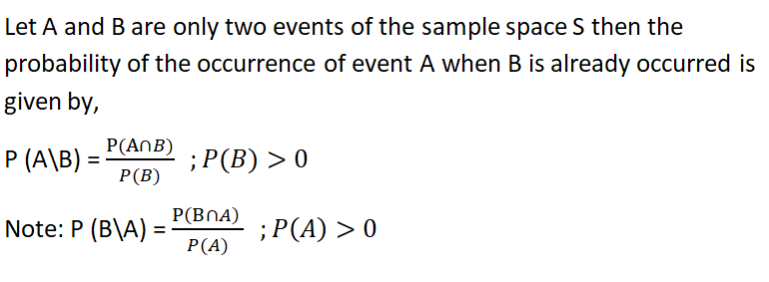

Conditional Probability & Properties

Slide 51
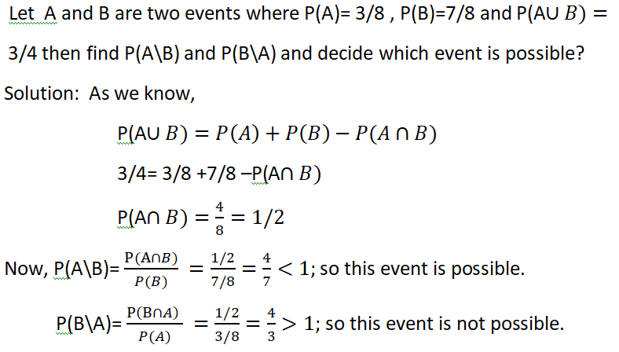
Example

Slide 52
Example

Slide 53
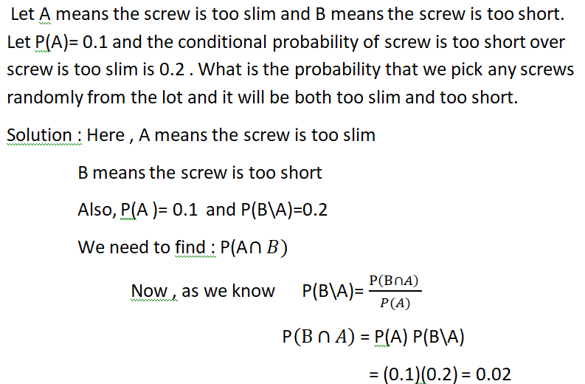
Example

Slide 54
Example

Slide 55
Example
In a box , 100 bulbs are supplied out of each 10 bulbs have defect of type A, 5 bulbs have defect of type B and 2 bulbs have defect of both the types.
Find the probability of (i) P(B\A) and (ii) P(B’\A’)

Slide 56
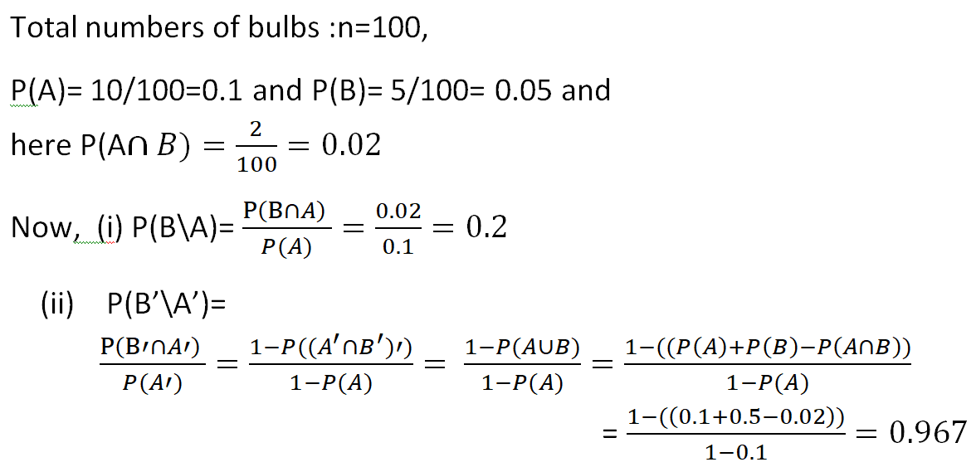
Solution

Slide 57

Que
 | Right handed | Left handed
Male | 0.41 | 0.08
Female | 0.45 | 0.06
Total
Find the Probability that a selected person is
A male given that the person is right handed.
Right handed given that a person is male.
A female given that the person is left handed.
Are the events being a female and being left handed, are independent?

Slide 58
Que
An urn contains 6 red balls and 4 green balls. We draw 2 balls without replacement and denote
R_{i} = the i^{th} ball drawn is red
G_{i} = = the i^{th} ball drawn is green
Find
(a) P(R₁)
(b) P(R₂/R₁)
(c ) P(R₂)
(d) Are the events R₁ and R₂ independent? Justify.
(c) and (d) we will see later)

Slide 59
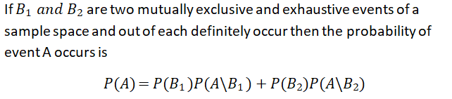
Total Probability

Slide 60
Que
An urn contains 6 red balls and 4 green balls. We draw 2 balls without replacement and denote
R_{i} = the i^{th} ball drawn is red
G_{i} = = the i^{th} ball drawn is green
Find
(a) P(R₁)
(b) P(R₂/R₁)
(c ) P(R₂)
(d) Are the events R₁ and R₂ independent? Justify.

Slide 61
Example
Three machines B1, B2 and B3 produce 30%, 45% and 25% of the products respectively. It is known from the past experiences that 2% ,3% and 2% of the products made by these machines are defective respectively. Suppose that a finished product is randomly selected then find the probability that it is defective.

Slide 62
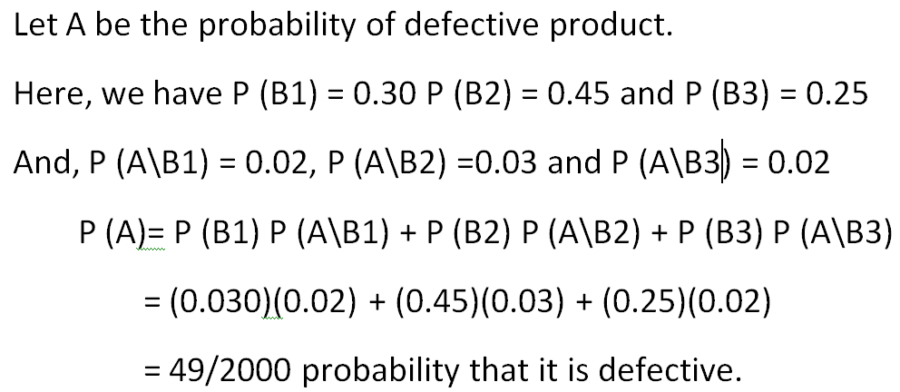
Solution

Slide 63
Independent Events
Let A and B be any two events of a sample space S then A and B are called independent if 𝑃(𝐴 ∩ 𝐵) = 𝑃(𝐴) ∙ 𝑃(𝐵)
Note :In the case of independent event,
P(A\B)= P(A) and P(B\A) = P(B)

Slide 64
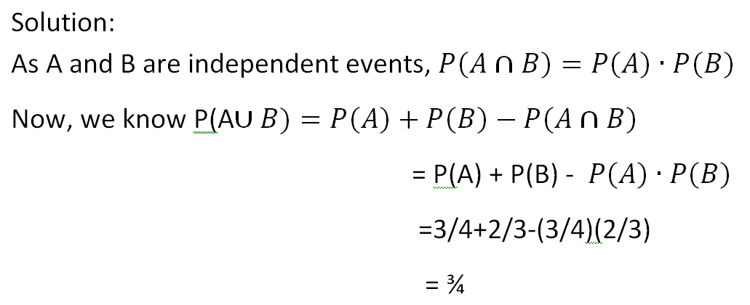
Example If A and B are two independent events and P(A) = 3/4 and P(B) = 2/3 then find P(A∪ 𝐵).

Slide 65
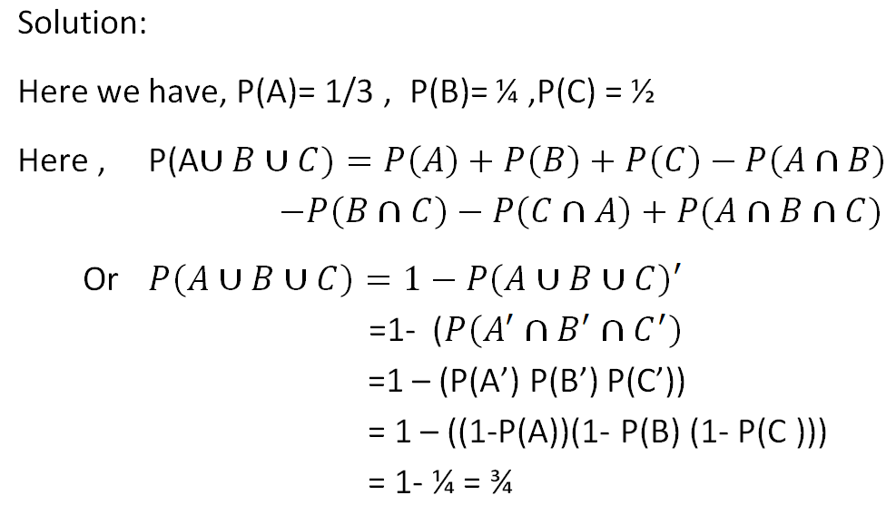
Example : A problem of statistics is given to 3 students A, B and C whose chances of solving each are 1/3, 1/4 and 1/2 respectively. What is the probability that the problem will be solved ?

Slide 66
Example
Three machines A, B and C are producing the products independently as in the rate of 1/5, 1/7 and 1/8 . Find the probability of the product that will be produced by A or B or C.

Slide 67
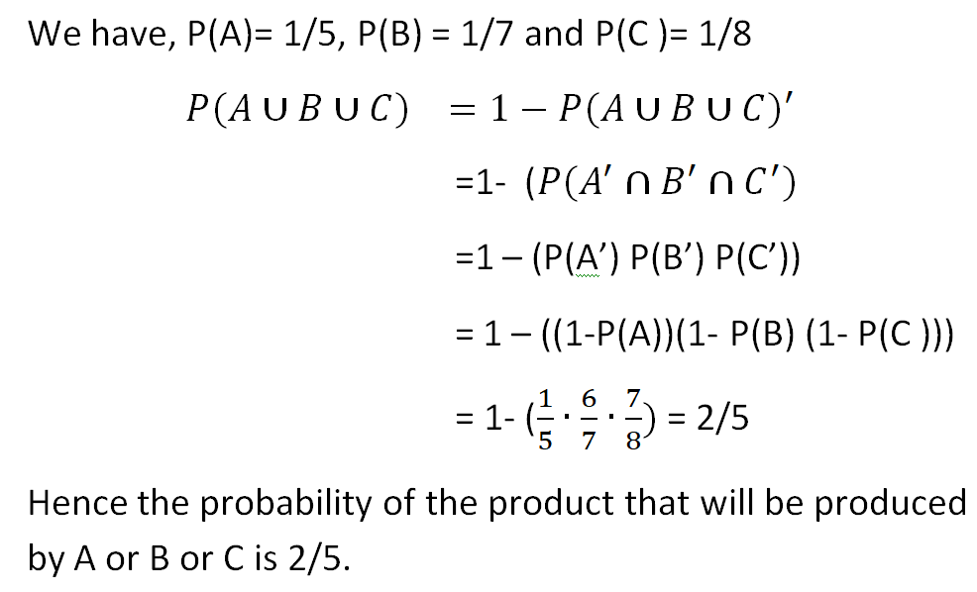
Solution

Slide 68
Question
If A,B,C are aiming to shoot a balloon. A will succeed 4 times out of 5 attempts. The chance of B to shoot the balloon is 3 out of 4 that of C is 2 out of 3. If the three aim the balloon simultaneously, then find the probability that at least two of them hit the balloon.

Slide 69
Solution
Now the probability that at least two of them hit the balloon is,

Slide 70
Baye’s Theorem
Let A₁ , A₂, A₃,…..A_{n} be n-mutually exclusive and exhaustive events of a sample space S and let B be any event, then

Slide 71
Example
Three boxes contain 10%, 20% and 30% of defective joints. A joint is selected random which is defective then determine the probability that it comes from (i) first box (ii) second box (iii) third box

Slide 72
Solution
Let us define events as below.
A : Selection of defective finger joint
B₁ : finger joint is from box – 1
B₂ : finger joint is from box – 2
B₃ : finger joint is from box – 3
P(B₁ )=1/3 , P(B₂ )=1/3 , P(B₃ )=1/3 ,
P(A/B₁ )=0.1 P(A/B₂ )=0.2 P(A/B₃ )=0.3

Slide 73
(a) The required probability ,

Slide 74
(b) The required probability ,
(c ) The required probability ,

